Slide 1
Heart Attack Chances
Patel Preet Rajeshkumar(N01511398)
ITE 5201 Humber College

Slide 2
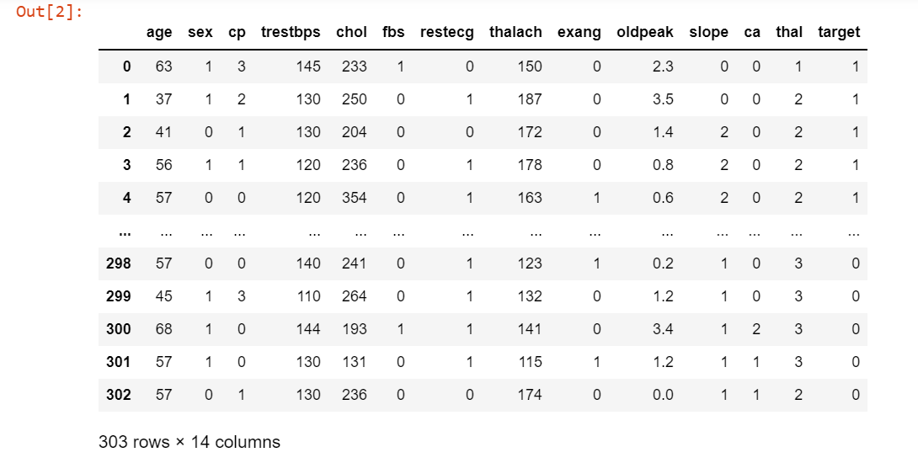
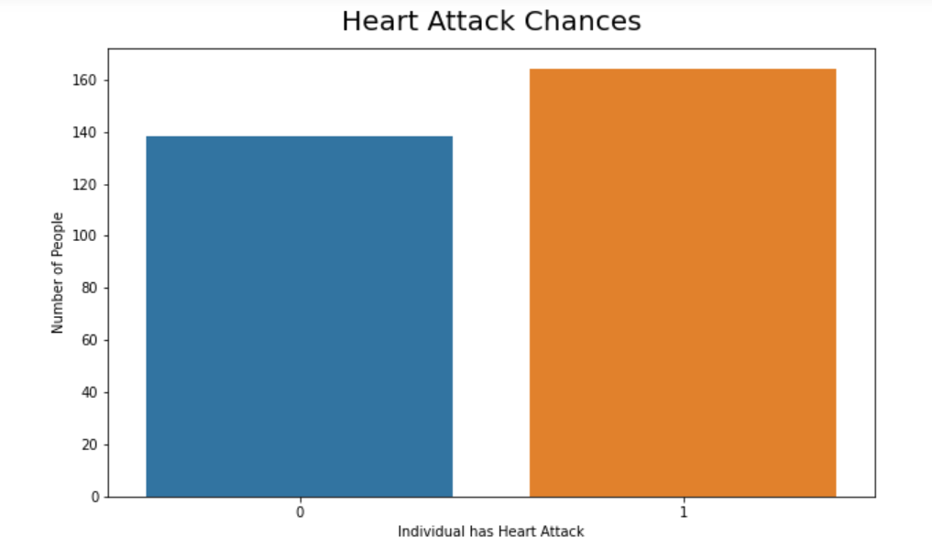
Problem Statement and Dataset Discussion
Problem Statement:
  It predicts whether the patient has less chance or more chance of heart attack.
Dataset Discussion:
  The dataset is used in predicting the possibility of heart attack. It has 14 features such as age, sex, chest pain type , resting blood pressure, serum cholesterol, maximum heart rate achieved, target etc.
  In the dataset, Sex column is already converted into binary for training the model in which 0 represents male and 1 represents female and chest pain type is also in integer which has any value between 0 and 4.
  Target field is in binary in which 0 shows the less chance of heart attack and 1 shows the more chance of heart attack.
  There are dependent variables such as age, sex, chest pain type, resting blood pressure, serum cholesterol, Maximum Heart Rate Achieved and the slope which I have used for training the model for prediction of heart attack chances.

Slide 3
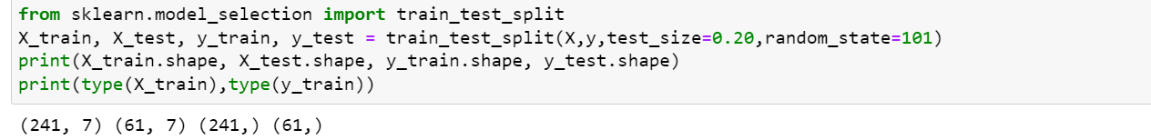
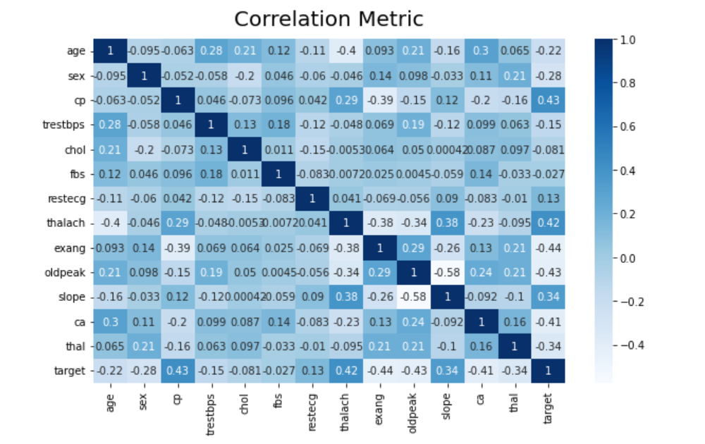
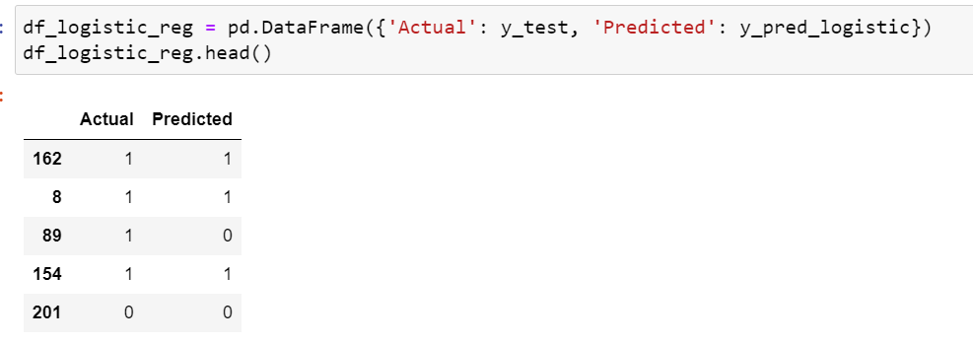
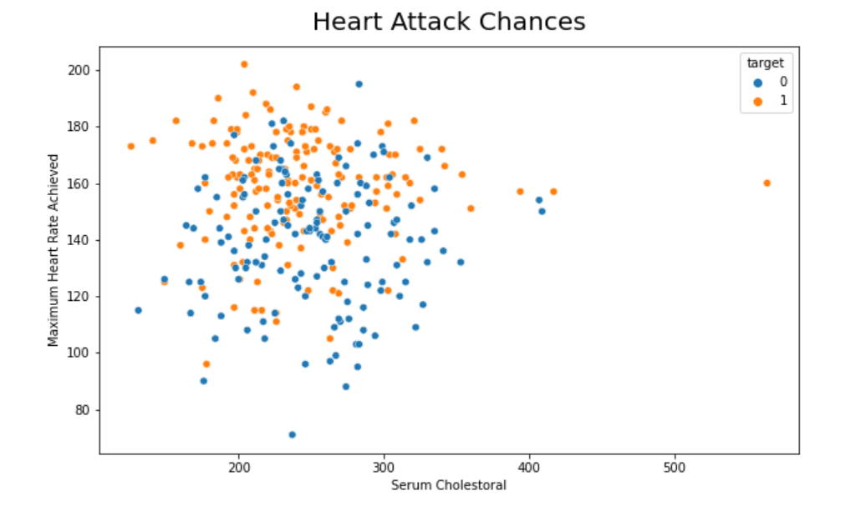
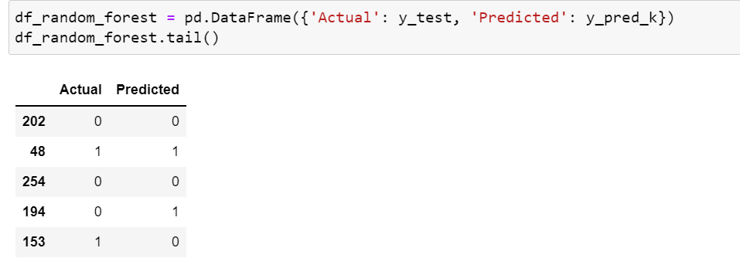
Proposed Analytical/Predictive Model
From the heatmap, it can be shown that it is highly dependent on chest pain, maximum heart rate achieved and slope.
From the below graph, it can be seen that if the serum cholesterol is between 200 to 340, there are higher chances of getting the maximum heart rate.
I have Split the data into 2 parts in which 80% of data is for training and 20% data is for testing.
I have used 2 models:
  1. Logistic Regression:
    After training and predictions of the model, it shows the output as follows:
  2. k-NN Model:
    After training and predictions of the model, it shows the output as follows:

Slide 4
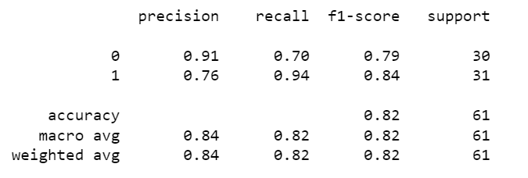
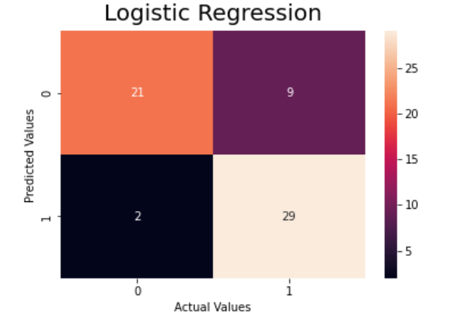
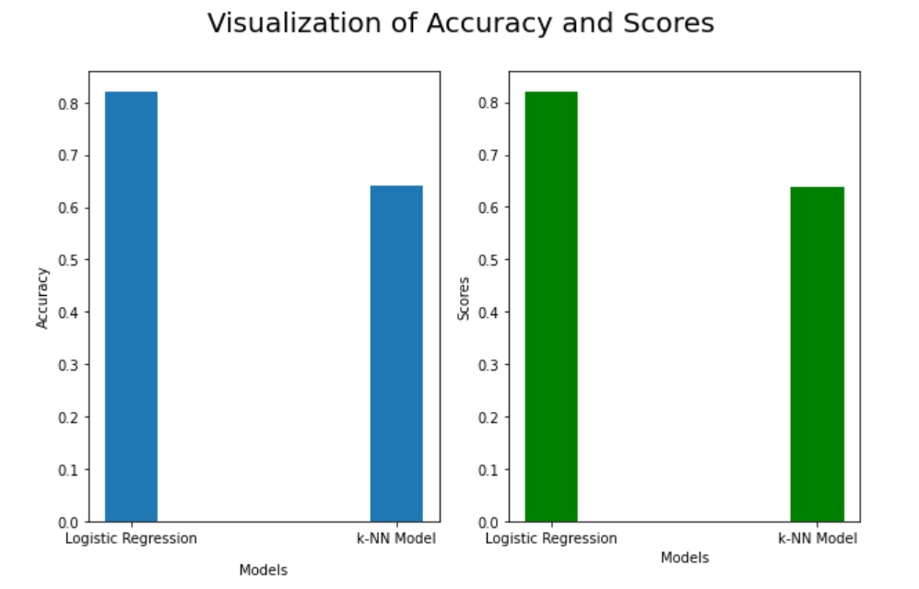
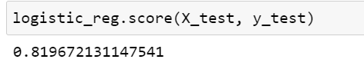
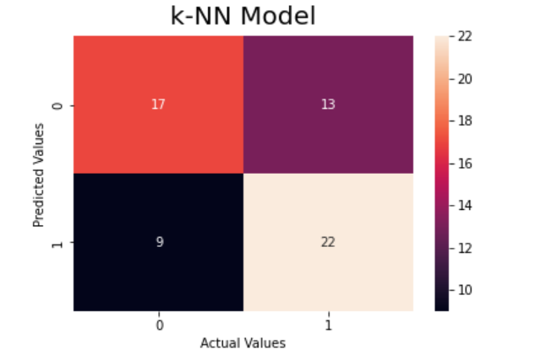
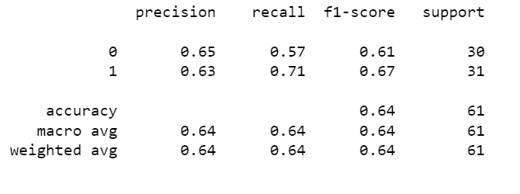
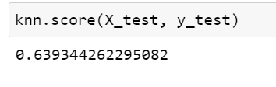
Results and Discussion
Conclusion:
  It can be seen from the graph that the Logistic Regression Model has an accuracy of 82% whereas the k-NN model has an accuracy of 64%.
  Therefore, for my dataset, the Logistic model is more accurate for the evaluation.
Logistic Regression:
k-NN Model:

